Slide 1
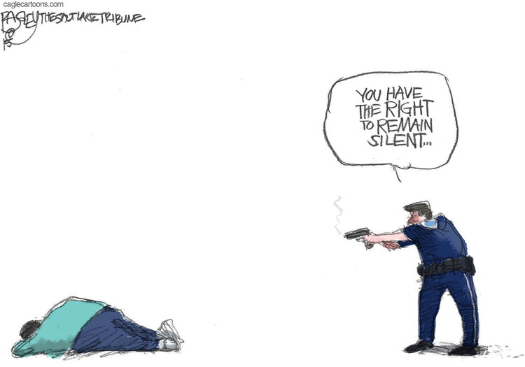
Fatal Police Shootings
In the US from 2015-2019
Alec Kim
Sadhna Chaurushia
Alejandra Soriano

Slide 2

Overview
What was the idea behind our topic?
Explore any insights into fatal police shootings btwn 2015-2019 based on the data
Where did we obtain our dataset?
https://github.com/washingtonpost/data-police-shootings/blob/master/fatal-police-shootings-data.csv
The approach behind our review
Use pandas and matplotlib to manipulate data and find any interesting results

Slide 3

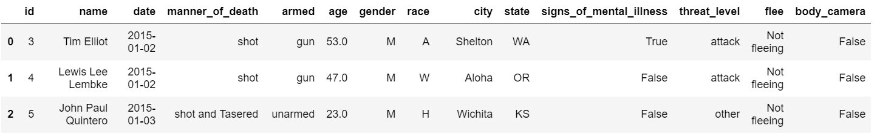
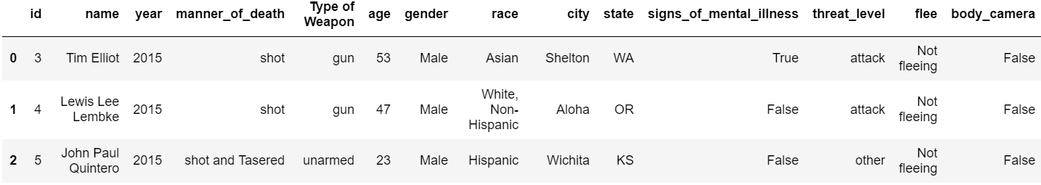
Data Cleaning (Before & After)
Original dataset from Washington Post
Post clean-up

Slide 4
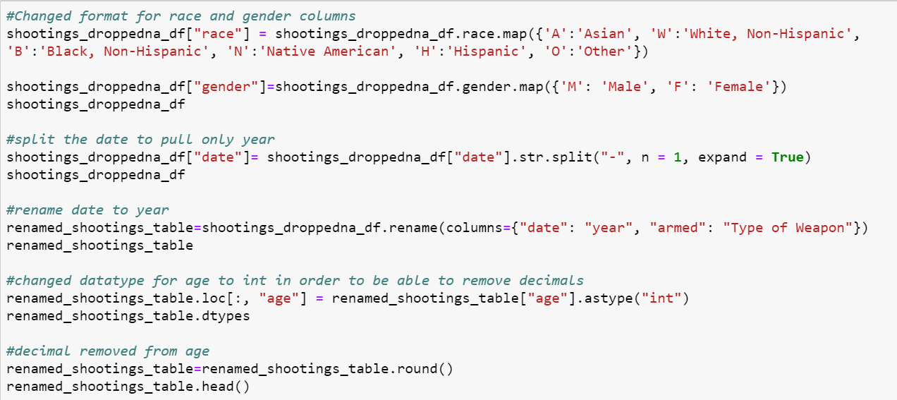
Data Cleaning (Code)

Slide 5
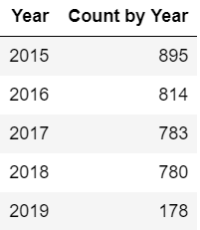
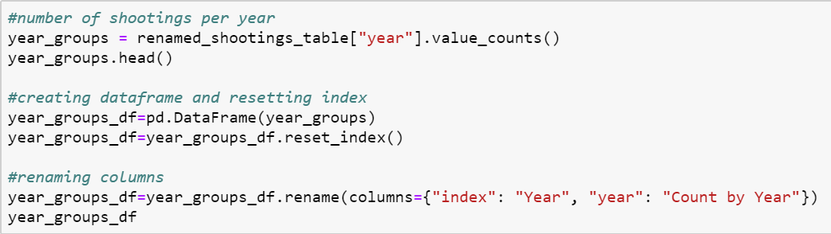
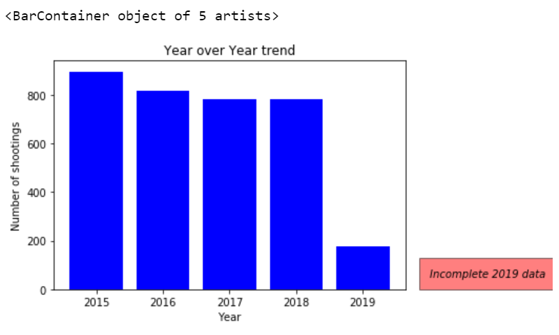
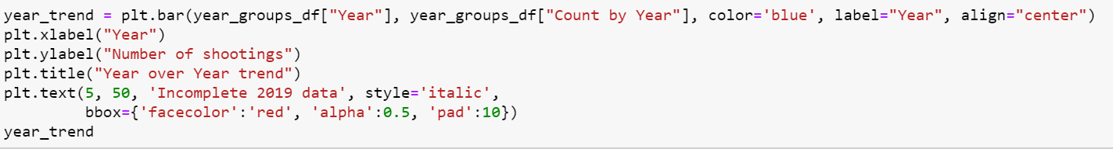
Five-Year Trend
Continuous decline in the past Five years.
2019 anticipated to be the least number of fatal shootings based on report date

Slide 6
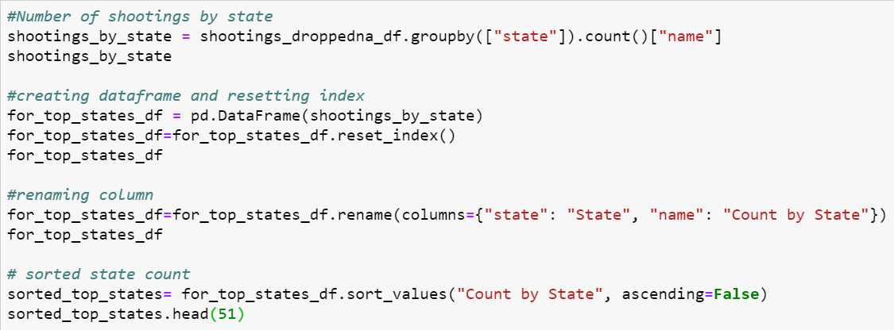
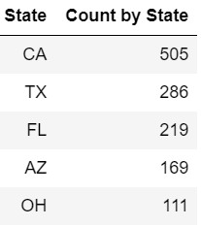
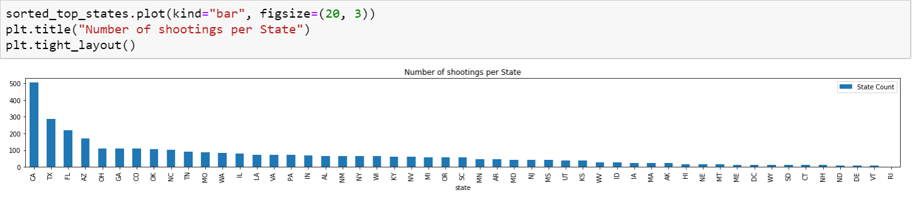
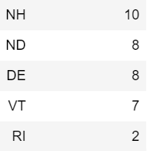
Number of Shootings by State
California had the highest number of fatal shootings followed by Texas and Florida
Rhode Island had the least number of fatal shootings followed by Vermont and Delaware

Slide 7
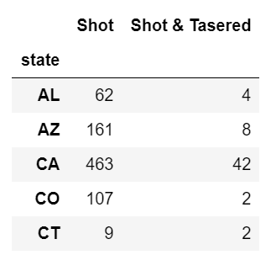
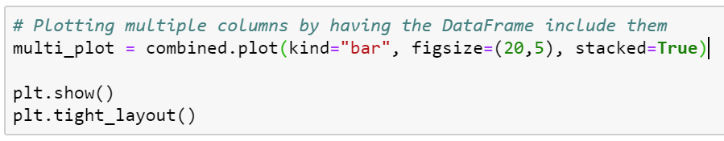
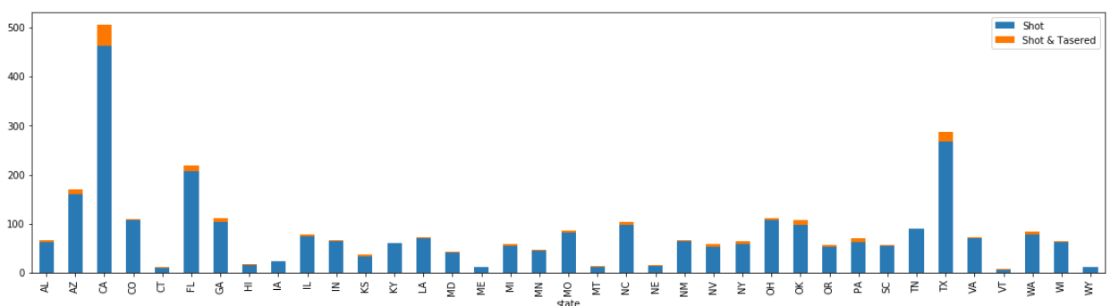
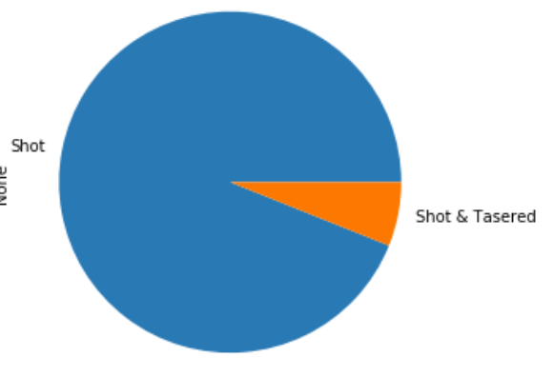

Number of Shootings by State ; categories
A different way to represent the data.

Slide 8
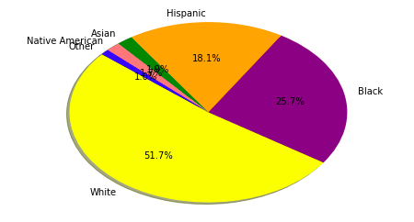
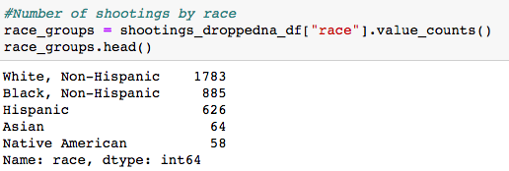
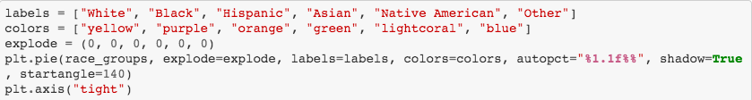
Breakdown by Race
Majority of victims were white

Slide 9
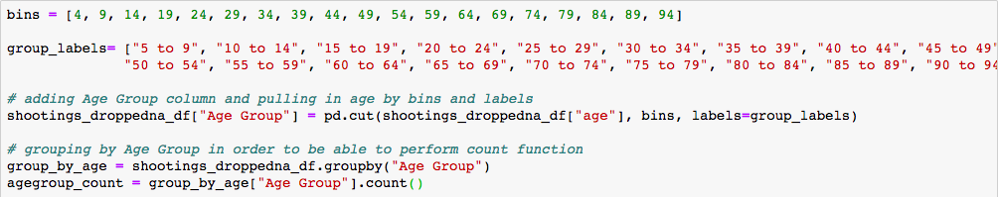
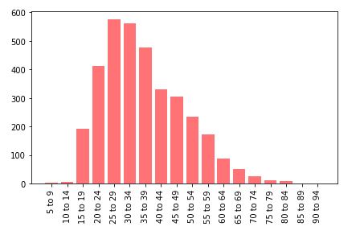
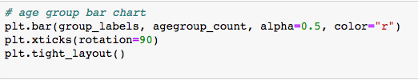
Breakdown by Age
ds
The highest number of victims was between the ages of 25 and 35

Slide 10
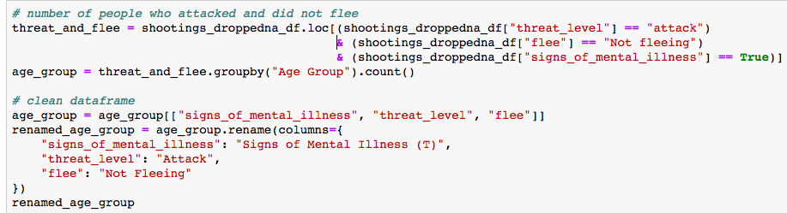
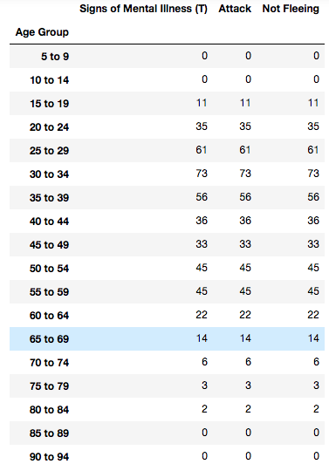
Breakdown by Age (contd.)
Victims who had signs of mental illness, attacked, and not fled were the most between the ages of 25-35

Slide 11
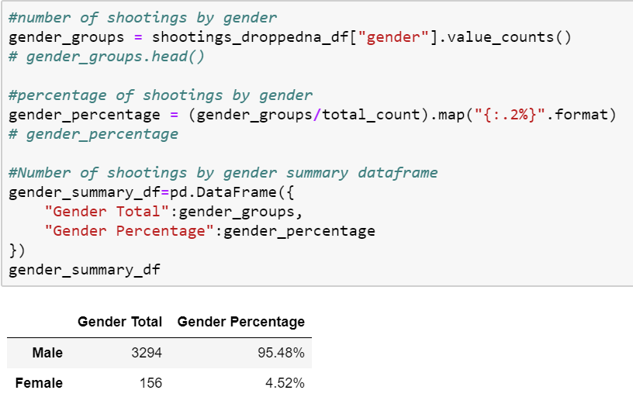

Extra analysis (Gender Breakdown)
95%
5%

Slide 12
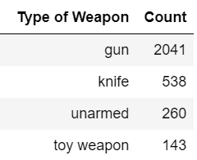
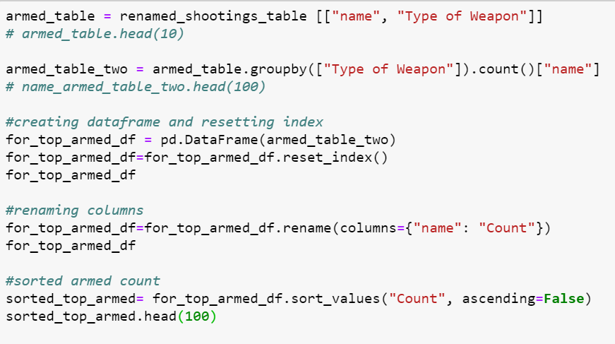



Extra analysis (Armed with)

Slide 13

overall Analysis
⁍ Decline in number of shootings but no significant decrease or pattern
⁍ Fatal shootings occured in both genders, all races, all age groups and whether the individual was armed or unarmed.
⁍ Data is somewhat limited in telling the specifics of certain columns, such as mental illness, threat level, fleeing

